Slide 1




Data Generator for SAP Solutions using Benerator Tool
Project Guide:Tim Böttcher
Baba Pakruddin Tailor
Julian Reddy Allam
Naga Sai Krishna Ayinampudi
Sai Rajesh Vanimireddy

Slide 2
Contents
Introduction
Requirements
Tools
Installation
Project Creation
Data Generation
Methodology
Business Analysis and Results
Conclusion
References

Slide 3
Introduction
Introduction
Developing a Data Generator
Big Data
Global Bike Inc.

Slide 4
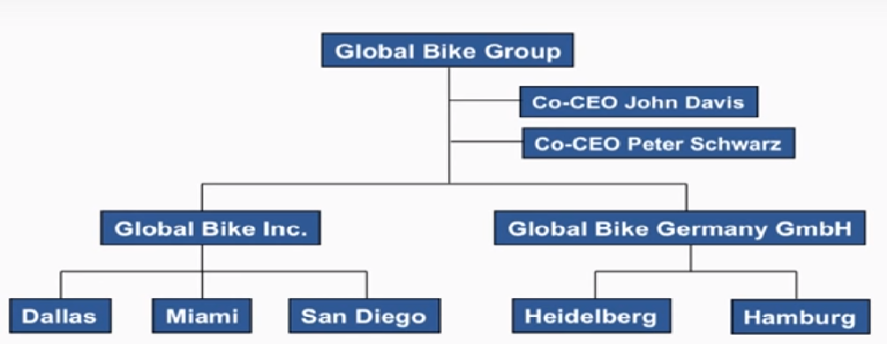
Introduction
GBI Company

Slide 5
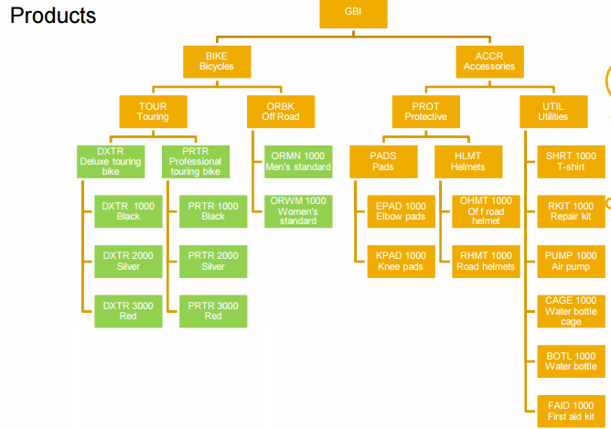
Introduction
GBI Products

Slide 6
Introduction
Enterprise Resource Planning (ERP)
Integration of people, information and process
Improves efficiency and transparency
Increases profitability and reduces Total Cost of Ownership

Slide 7
Introduction
Enterprise Resource Planning (ERP)
SAP ERP Financials
SAP ERP Human Capital Management
SAP ERP Operations
SAP ERP Corporate solutions

Slide 8
OnLine Analytical Processing (OLAP)
An approach to answer multidimensional analytical queries
Big data volumes per operation
Historical (2-7 years),multiple datasources
Generates knowledge

Slide 9
GBI Business Processes
Order To Cash (OTC)
ERP Modules
- Sales & Distribution
- Material Management
- Finance
Procure To Pay
ERP Modules
- Material Management
- Finance

Slide 10
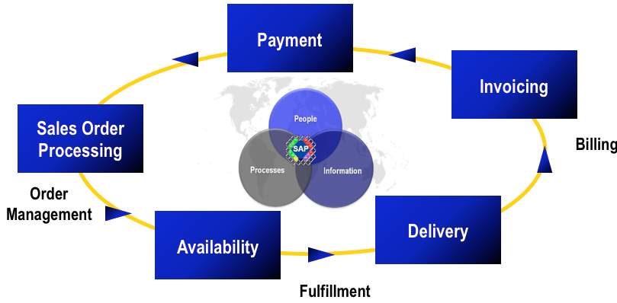
Source:Threem.co.id
Order to Cash

Slide 11
Order to Cash
Process Steps
- Sales order processing
- Availability
- Delivery
- Invoicing
- Payment

Slide 12
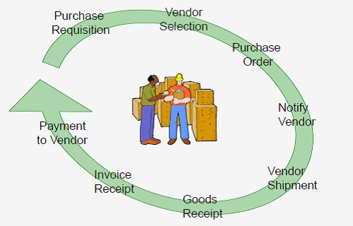
Procure to Pay
Source:victorstinga.files

Slide 13
Procure to Pay
Steps
- Creating Suppliers
- Preparing the purchase order
- Goods Receipt
- Invoice processing

Slide 14
Requirements
Master Data
- Core data
- Basis for any business processes
Ex - Master data of Customers ,Vendors and Products

Slide 15
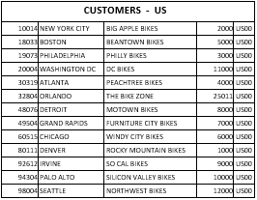
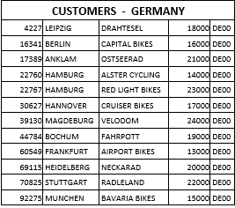
Master data of GBI Customers

Slide 16
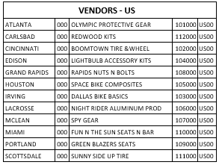
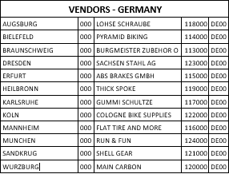
Master Data of GBI Vendors

Slide 17
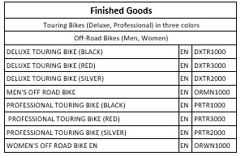
Master Data of GBI Products

Slide 18

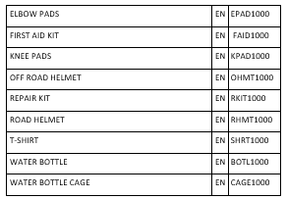
Semi Finished Goods
Trading Goods

Slide 19
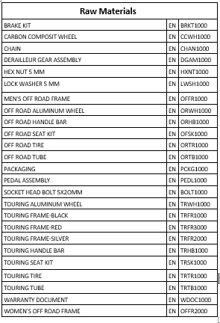
Raw materials

Slide 20
Tools
MySQL Workbench
Benerator (open source tool)
Secure WAMP

Slide 21
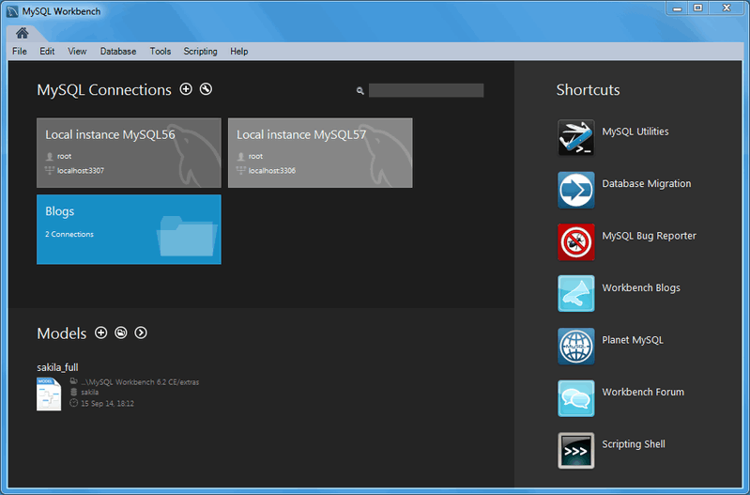
My SQL
Open source Relational Database system

Slide 22
Benerator Tool
Test data generation Tool
Huge volume of data
Easily Customizable
Reduces time
Supports Database Systems, XML, Excel sheet, CSV etc.
13-07-2016
Title : Data Generator using Benerator Tool
22

Slide 23
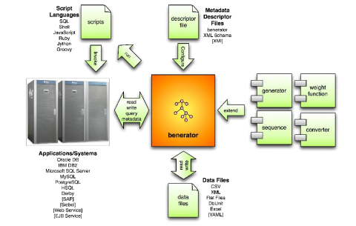
Benerator Block Diagram
Reference: http://databene.org/download/databene-benerator-manual-0.7.6.pdf
13-07-2016
Title : Data Generator using Benerator Tool
23

Slide 24
Installation of My sql Instructions
Download and Install My sql workbench
Set user name and password for the database.
Create a database
create customer, product, vendor, material master data tables for US and Germany and insert the given values into the tables.

Slide 25
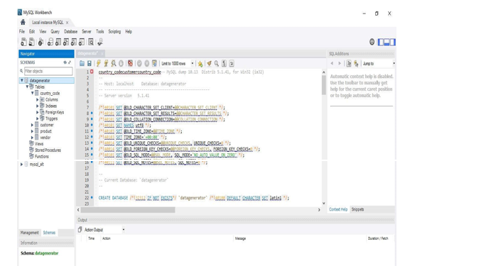

Slide 26
Installation of Benerator Tool Instructions
Download the Benerator tool using the link http://bergmann-it.de/download/download_benerator
Set benerator_Home and Java_home environment variables
Set maven variables in system variables

Slide 27
Installation of Benerator Tool Instructions
Start project wizard on command line by typing
benerator-wizard-bat
Depending on our language settings, GUI window will be opened as shown.

Slide 28
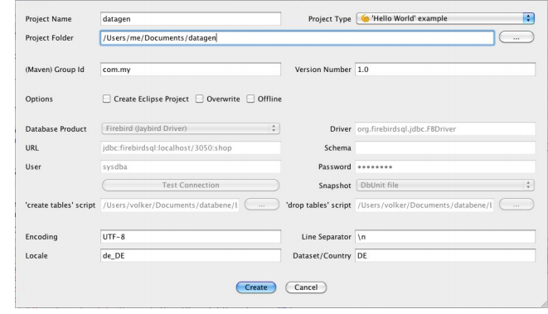

Slide 29
Project creation
In the GUI, select project type as populate database
Create new project folder
Select the database product as My SQL.
Enter the driver details : jdbc:mysql://localhost:3306/<database name>
Enter username and password

Slide 30
Project creation
Click on create a project, which will produce benerator.xml, pom.xml, read me, base.dbunit files in the target project folder
Benerator.xml is a descriptor file which is used data generation
POM.xml contains plugins, project dependencies, project versions etc.
Read me file give instructions to generate data

Slide 31
Data generation
benerator descriptor file is XML based
Document root is <setup> element
<generate> elements are used to generate data from scratch
It provides different configuration options for data generation

Slide 32
Methodology
Entities may be generated completely synthetically
Entities as well as their attributes can be imported from storage systems or data files which serve as prototypes for huge volume data generation

Slide 33
Methodology
As we have master data tables of customer, product, vendor and material in the database
we have queried the customer id and product id by using
<reference> elements
This will produce the required data to the sales order table

Slide 34
Methodology
<generate type="salesorders_de" count="10000" consumer="db,ConsoleExporter">
<id name="orderid" type="integer" />
<reference name="customerid" type="int" targetType="salesorders_de" source="db“ selector="select id from customer_de" nullable="false" cyclic="true" distribution="random"/>
<reference name="productid" type="int" targetType="salesorders_de" source="db" selector="select pid from product_de" nullable="false" cyclic="true" distribution="random"/>
<attribute name="quantity" type="integer" min="0" max="10" distribution="cumulated" />
<attribute name="sale_time" type="datetime" generator="dtGen"/>
</generate>

Slide 35
Methodology
Execution of above code in benerator.xml using the command mvn benerator : generate in command prompt will produce 10000 rows in the salesorder table
we can export the file into csv, xls or other file formats or selecting the database as receiving object in consumer element

Slide 36
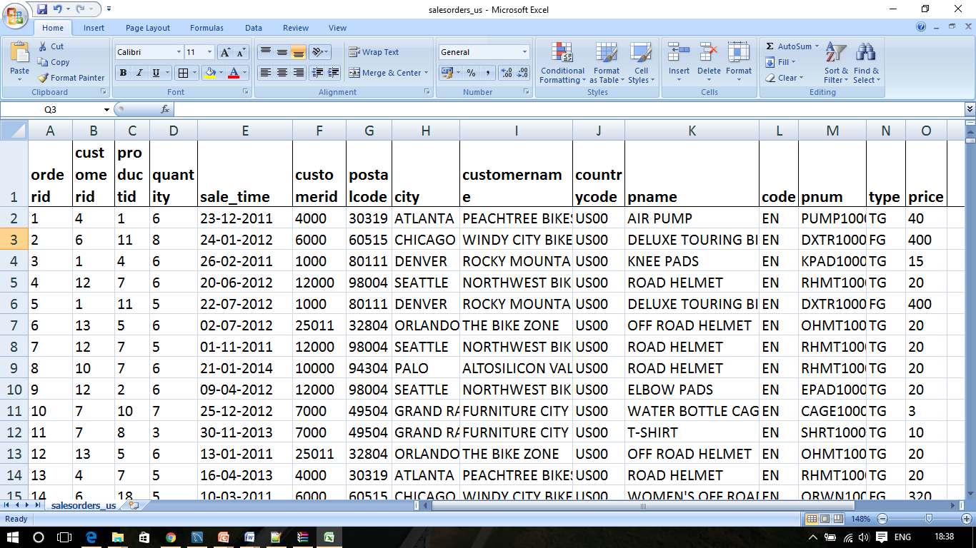
Salesorder data
Generated Data

Slide 37
Business Analysis and Results
Analysis of past performance
Used to derive new insights and understanding
Explore the unknown and discover new patterns
Types :
- Descriptive
- Predictive
- Prescriptive

Slide 38
Business Analysis and Results
Descriptive Analysis :
- what happened in the past
Ex : Dashboards, scorecards
Predictive :
- what will happen
Ex : Data mining,Forecasting
Prescriptive :
- what should i do
Ex : optimization,simulation

Slide 39
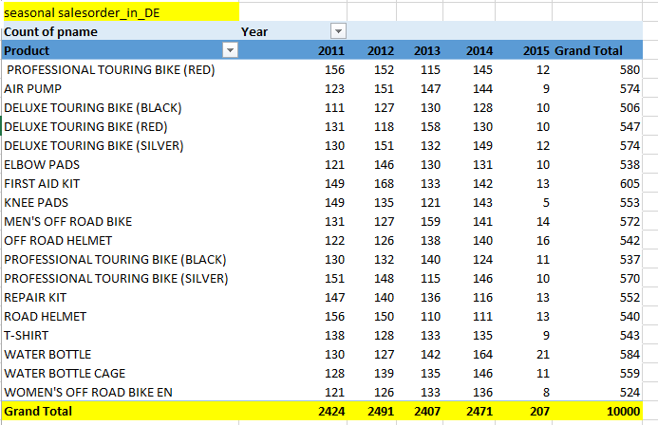
YoY sales volume in germany

Slide 40
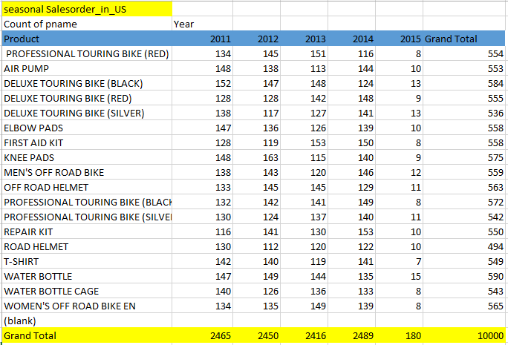
YoY sales volume in USA

Slide 41
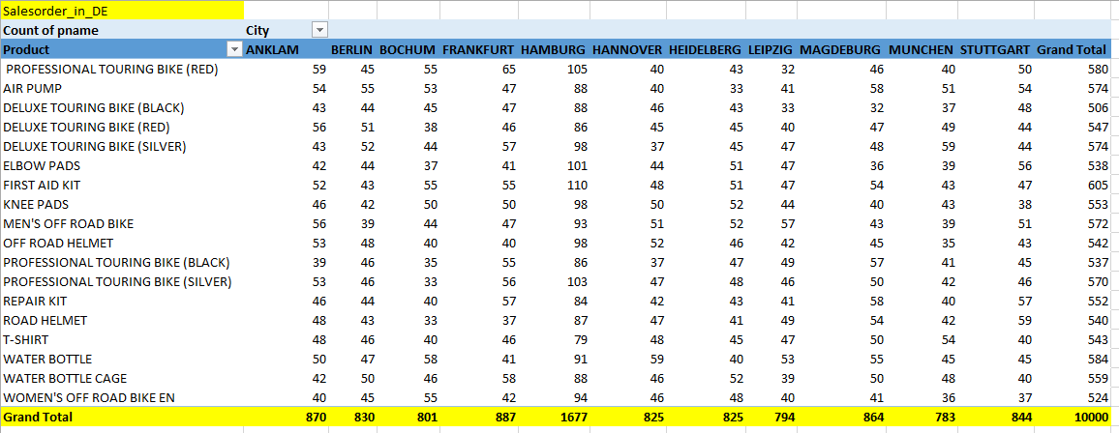
Regional-wise sales in Germany

Slide 42
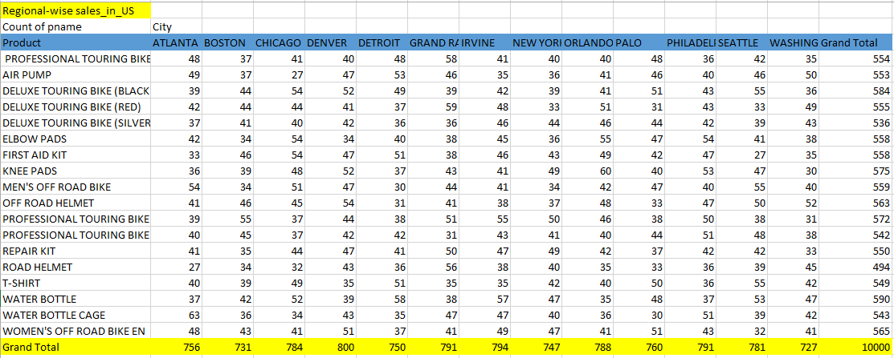
Regional-wise sales in USA

Slide 43
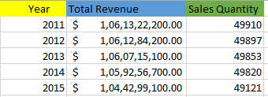
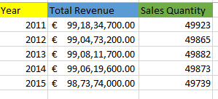
Total Revenue in USA and Germany

Slide 44
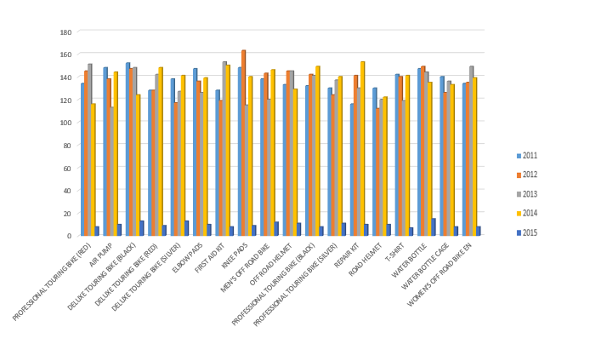
Product wise sales in Germany

Slide 45
Product wise sales in USA

Slide 46
Regional-wise sales graph in USA

Slide 47
Regional-wise sales graph in Germany

Slide 48
Conclusion
As per the requirements and data types given by the user, benerator has generated the data
Data has analysed and the outcome has been reported in the graphs

Slide 49
References
http://databene.org/databene-benerator
Synthetic data generation using benerator tool
https://csiweb.ucd.ie/files/UCD-CSI-2013-03.pdf
https://datamegan.files.wordpress.com/2015/09/2-a-data-warehouse-and-business-intelligence-solution-for-global-bike.pdf
http://www.sdn.sap.com/irj/scn/go/portal/prtroot/docs/library/uuid/e01b8d27-ff8b-2d10-5483-a44659b649a2?QuickLink=index&overridelayout=true&48752174280003

Slide 50
Thank You

